Slide 1
Geothermal Energy for Agriculture
Notes:
The adjective geothermal originates from the Greek roots γη (ge), meaning earth, and θερμος (thermos), meaning hot.

Slide 2
Course Content
Geothermal Basics
-Introduction & History
-Electricity Production
-Direct-Use
-Geoexchange
-Potential, Pros & Cons
Geothermal Heat Pumps
-Horizontal Loop
-Vertical Loop
-Pond Loop
-Open Loop
-Hybrid Designs
3) GHP Subsystems
-Earth Connector
-Heat Transfer Unit
-Distribution System
-Water Heating
-Efficiency & Versatility
4) Project Development
-Site Considerations/Sizing
-Cost/Installation/Maintenance
-Economics/Funding
-Data Systems
-Additional Resources
Notes:
Below are the units covered in this module with corresponding slide numbers in parentheses:
1) Geothermal Basics (4-23)
-Introduction
-History
-Electricity Production
-Direct-Use
-Geoexchange
2) Geothermal Heat Pumps (24-36)
-Horizontal Loop
-Vertical Loop
-Pond Loop
-Open Loop
-Hybrid Designs
3) GHP Subsystems (37-45)
-Earth Connector
-Pump
-Distribution System
-Water Heating
-Efficiency & Versatility
4) Project Development (46-55)
-Site Considerations/Sizing
-Cost/Installation/Maintenance
-Economics/Funding
-Data Systems
-Additional Resources

Slide 3
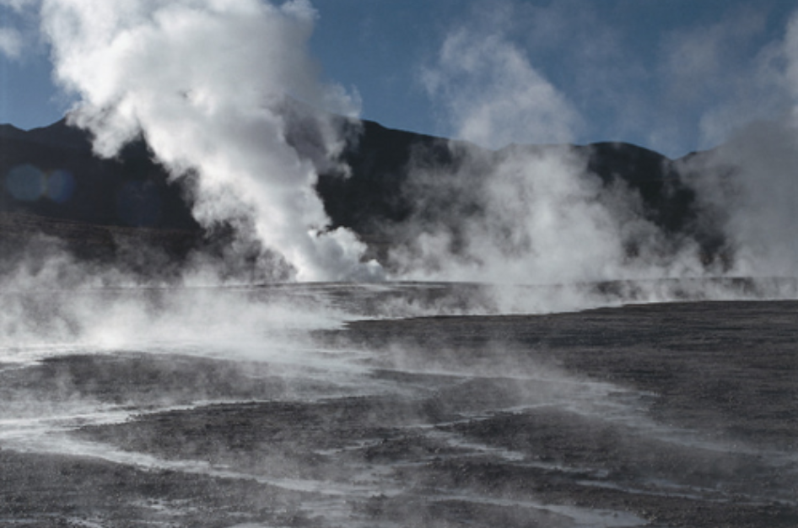
Hmmm…
Where does the Earth’s heat come from and how can we use it?
Notes:
See what students already know about geothermal and its applications. Ask if anyone has an example of a geothermal system.
Hint: There are two sources of geothermal heat.
Answer: From the core (radioactive decay) and from the sun (stored radiant heat).
We can use it to generate electricity and for heating and cooling purposes.

Slide 4
1: Geothermal Basics
Introduction & History
Electricity Production
Direct-Use
Geoexchange
Potential
Pros & Cons

Slide 5
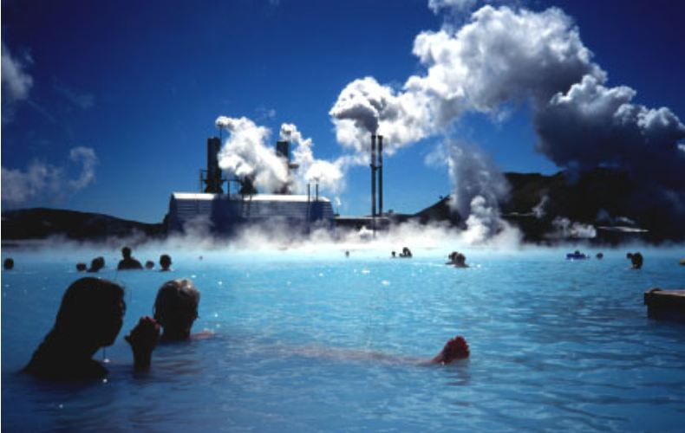
Introduction to Geothermal
Geothermal energy is heat that
is generated (from the core)
and stored (from the sun)
inside the Earth.
Geothermal places third among renewable energy production, following hydroelectricity and biomass.
Notes:
Ask students what makes geothermal a renewable source of energy,
and to give examples of geothermal applications they are aware of.

Slide 6
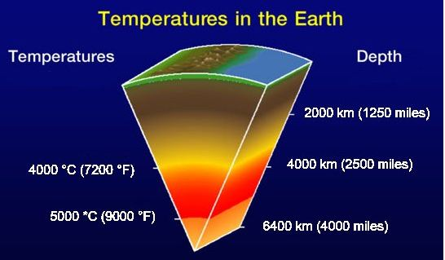
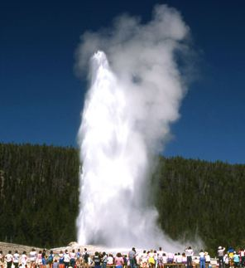
Our Free Solar Energy Storage System
The core of the Earth is kept hot by
radioactive decay while the surface
is kept warm by solar radiation.
Geothermal “energy” is extracted
from the depths of the Earth.
Geothermal heating and cooling
(Geoexchange) is extracted
from just below the Earth’s
surface.
This is why we refer to the
Earth as our free solar
energy storage system.
Notes:
It is also presumed that some of the core’s heat (~10%) is residual from it’s initial creation (the “Big Bang”).
(SOURCES : NREL & geoguy.com)

Slide 7
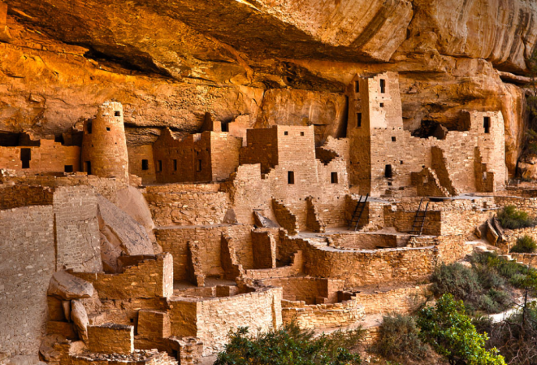
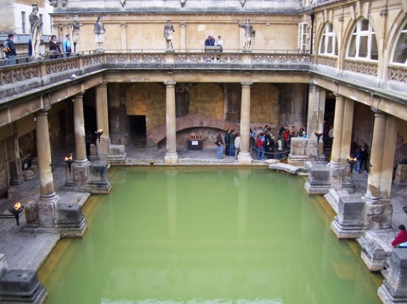
Early History of Geothermal Uses
2.5 million years ago:
Our ancestors found
their first “climate
controlled home” in caves
10,000 years ago:
American Indian cliff dwellings
1,500 BC: Romans used
geothermal to heat buildings
Notes:
Interesting note: Many archeologists and anthropologists believe that hot springs were neutral zones where members of warring nations would bathe together in peace.
Human beings have used geothermal energy in North America for at least 10,000 years. Paleo-Indians used hot springs for cooking, and for refuge and respite.
http://www1.eere.energy.gov/geothermal/history.html

Slide 8
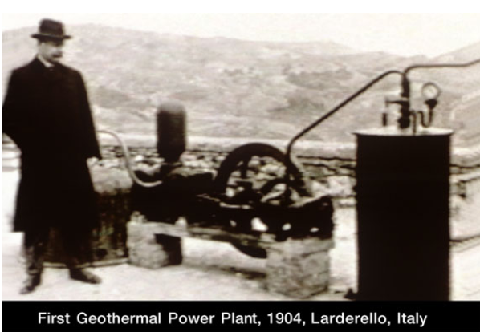
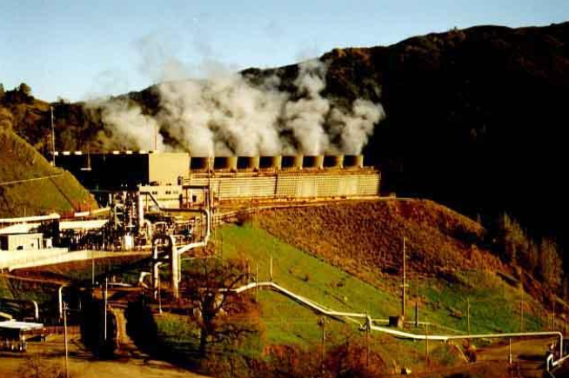
Recent Geothermal Developments
1892: Boise, Idaho, installs geothermal district heating
1904: Italian scientist powers light bulbs with geo-steam
1913: 1st geothermal electric power produced in Italy
1922: 1st US geothermal power plant built in CA
1926: 1st commercial greenhouse heated by geothermal
1930: 1st downhole heat exchanger for home heating
1960: 1st large-scale geo-power plant produces 11 MW
1970: U.S. Geothermal Resources Council formed
1978: 1st geothermal food-processing (crop-drying) plant
1984: 20-MW plant begins generating power in UT
2000: Dept. of Energy introduces GeoPowering the West
2012: U.S. geothermal electricity production at 3,086 MW,
leading total world production of 10,715 MW
The Geysers power plant, CA
Notes:
http://geothermalenergy.webnode.com/timeline
http://www1.eere.energy.gov/geothermal/history.html
Highlight Italy as being the first country to produce geothermal electric power.

Slide 9
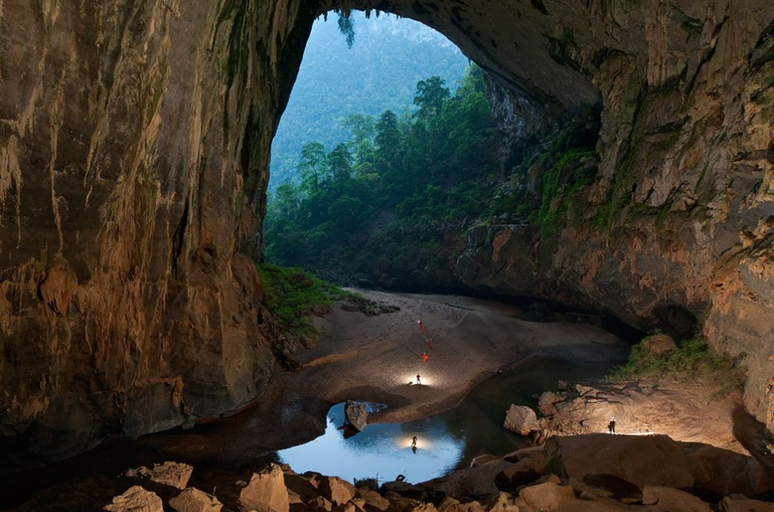
Discussion
How did humans first use
geothermal energy?
Notes:
Beyond the basic answer of cave dwellings, ask students why they think subterranean temperatures remain constant.

Slide 10
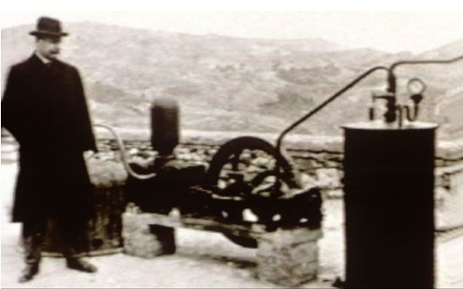
Pop Quiz!
What country first produced
geothermal electricity?

Slide 11
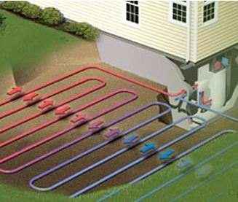
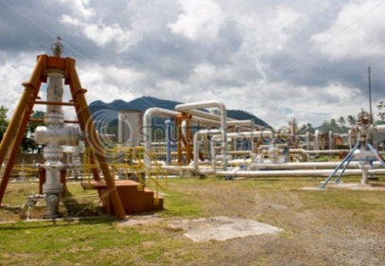
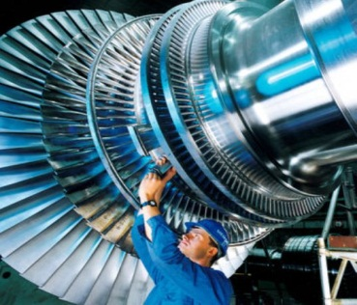
Types of Geothermal Energy
1. Geoexchange
Used to heat and cool air and water through a simple temperature exchange with the constant temperature of the Earth just a few feet below the surface. Efficient, practical & available everywhere.
2. Geothermal Direct-Use
Hot water is pumped out of deep geothermal reservoirs and through heat exchangers and control units to warm air and water for various uses.
3. Geothermal Electricity Production
Electricity generated by steam-powered turbines from deep sources of heat over 300°-700°F.
Ground-source heat pump
Direct-use geothermal well
Steam Turbine
Notes:
The first two (electricity production and direct-use) involve tapping into deep heat reservoirs, usually several miles deep, that are fueled by ongoing radioactive decay in the Earth’s core.
Geoexchange uses the constant temperature that exists at very shallow depths (generally between 4-6 feet below ground) for basic heating and cooling with the energy-efficiency technology of ground-source heat pumps.
The following slides summarize the types of geothermal energy, with a Ground-source heat pumps (using geoexchange) will be the focus of this unit as they can be low-cost and more easily installed and applied to farm operations.
The three titles above are linked to web pages for further details and illustrations.

Slide 12
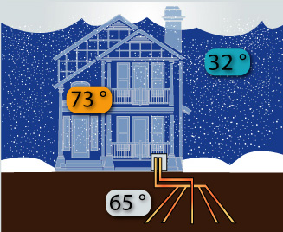
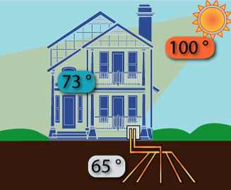
1. Geoexchange
The sun’s radiation heats the Earth’s crust and is stored underground. Soil 4-10 feet-deep stays between 40º-80ºF.
Heat is absorbed from the ground into liquid-filled pipes that are circulated into buildings for space and water heating.
The reverse process can be used for cooling purposes.
Notes:
A few feet beneath the surface (approx. 4-10’), the earth's temperature remains fairly constant year-round, ranging from 40º or so in northern latitudes to about 80ºF in the deep south (55º average).
Geoexchange takes advantage of this constant temperature to provide extremely efficient heating and cooling by circulating piped liquid through the ground, up into a building and back again..and again.
DISCUSSION: Can anyone give an example of this from personal experience? (ex: inside a cave, feeling the soil inside a freshly-dug hole…)

Slide 13
Geoexchange Video
Over 3 million American homes have geothermal systems.
Geo-Exchange is also known as “Earth-Coupled” or “Ground-Source”
Notes:
This 4 minute video offers an explanation of the various geoexchange technologies.
http://www.youtube.com/watch?v=NBHHqw6TRXk&feature=related

Slide 14
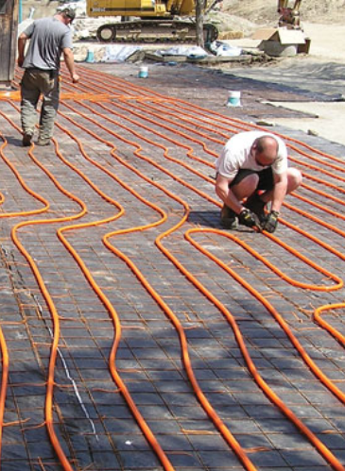
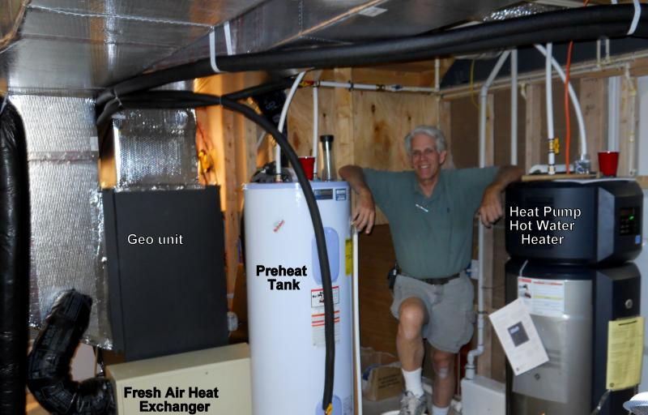
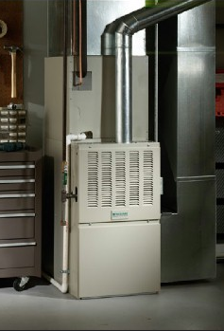
Geoexchange Ag Applications
Heating and cooling for farm buildings of all types
Water heating & cooling for dairies, cleaning, etc.
Geoexchange can save 30-50% on energy costs!
Notes:
System concepts explained are later on.

Slide 15
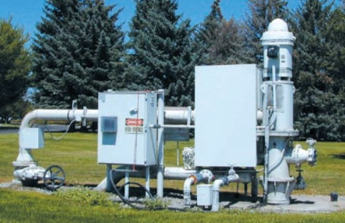
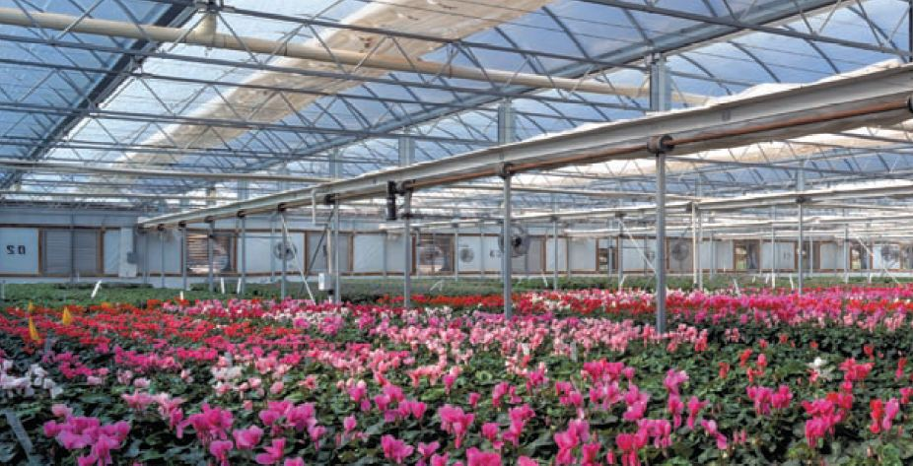
2. Geothermal Direct-Use
DIRECT USE of hot water from deep geothermal reservoirs
without the necessary use of heat exchangers
Components:
Production facility
Mechanical System
Disposal System
Direct-use systems can save up to 80% on energy costs but requires complex installation.
LINK 1 LINK 2 LINK 3
Notes:
If your region is known for reasonable access to geothermal reserves, you may want to present this technology in more depth to your students.
LINK 1 & LINK 2 go to websites with additional information. There is also a good 16 page Dept. of Energy document called “Direct Use Geothermal DOE” in the HANDOUTS section for distribution to the class, which is also accessed by going to LINK 3.
Direct-use systems also require deep drilling and are typically composed of three components:
• A production facility – usually a well – to bring the hot water to the surface, in excess of 200°F
• A mechanical system – piping and controls – to deliver the heat to the space or process
• A disposal system – injection well, storage pond, or river – to receive the cooled geothermal fluid
Although ‘direct use’ implies no need for a heat pump or exchanger, some installations do employ these technologies for added efficiency and applications.

Slide 16
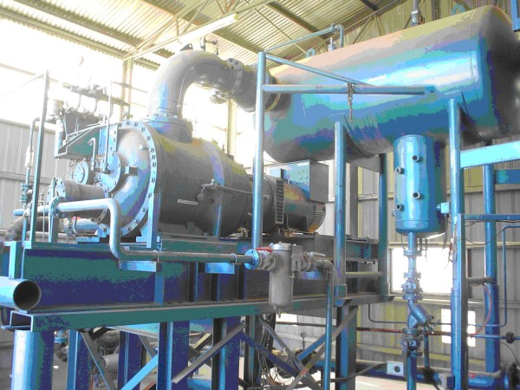
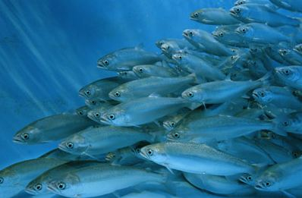
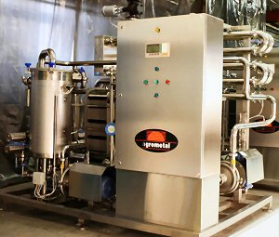
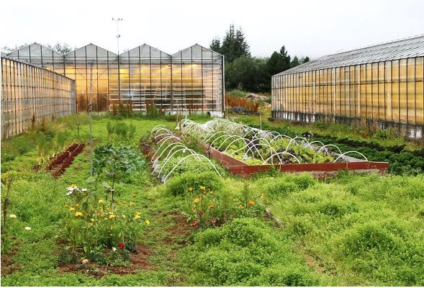
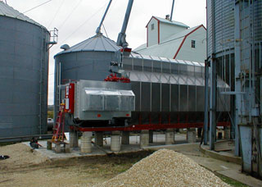
Direct-Use Ag Applications
Space Heating
& Cooling
Hot Water
Season Extension for
Greenhouses & Fields
Crop Drying
Refrigeration
Aquaculture
Soil Sterilization for pest & fungus control
Food Processing
& Dehydration
Pasteurization
Small-scale power generation
Notes:
(Some of these applications are only being used on a small scale, such as steam sterilization of soil)
Space Heating & Cooling
Space heating of an individual building is fairly easy to justify economically, provided the heating load is large enough. Adapting an existing system to use geothermal heat is a straightforward process. This application is discussed in following slides.
Greenhouses
Heating greenhouses with geothermal water helps maintain a constant temperature, resulting in a more reliable crop and faster-growing plants. The water in the pipes can be released into the air inside the greenhouse, raising humidity if necessary.
There are several techniques used to heat greenhouses with geothermal water. These include plastic tubes, finned pipes, finned coils, soil heaters, or unit heaters. These parts can be combined according to water temperature and the preferences of the grower and the plants. For example, a grower producing roses would want to create a heating system with good air circulation and low humidity. A grower producing tropical plants could adjust the system to create high humidity and high soil temperatures.
Chinese shiitake mushroom growers in Fujian province use geothermal heat in a greenhouse to speed production time.
Two large greenhouses at the La Carrindanga Project in Bahia Blanca, Argentina, have been using geothermal pipes to heat their facilities. These greenhouses have sliding glass side panels that can open and close to regulate humidity and heat, and misting systems to water plants and maintain moisture in the air. The geothermal water runs through pipes buried just beneath the surface of the soil, where the heat from the water easily reaches plant roots. Boxes containing dirt and seeds can sit on top of these pipes so that they receive heat from below. The beds grow vegetables, flowers, and indoor and outdoor plants from seeds and cuttings. Bahia Blanca has an unreliable climate and is not a very good location for outdoor agriculture, but its geothermally heated greenhouses are very productive and reliable.
Open field agriculture
Geothermal water can be used to keep the soil in open fields at a steady warm temperature. Farmers run irrigation pipes under the soil to provide both water and heat to the crops. Using geothermal water for irrigation extends the growing season and keeps plants from being damaged by low air temperatures.
Geothermal water can also sterilize soil to kill pests, fungus, and diseases that can harm crops. Sterilization requires very hot water so that the steam can be applied directly to the soil. The farmers either heat the soil from pipes underneath it, or they apply the steam above the soil and cover it with a plastic sheet to keep the heat inside.
Crop Drying
The heat from geothermal water can also be used to dry crops and timber. For example, since the mid-1980s the Broadlands Lucerne Company in New Zealand has been using geothermal steam to dry alfalfa.
Refrigeration
Geothermal energy may be used for cooling through the absorption cycle process.
Aquaculture
Geothermal aquaculture uses naturally occurring warm water to accelerate the growth of fish, shellfish, reptiles, amphibians, and aquatic plants.
Rearing fish in controlled temperatures can boost growth rates by 50 to 100%.
Fish and other species can be raised in simple open air earthen ponds or sophisticated fiberglass tanks.
Water quality is extremely critical:
– Temperature, dissolved oxygen, nitrogenous wastes, pH, alkalinity, hardness, carbon dioxide, salinity, chlorine, and hydrogen sulfide
Benefits and drawbacks of agricultural applications
Geothermally heated greenhouses are especially useful in marginal areas where the climate is unreliable. They make plant and vegetable production more efficient, and they reduce the time it takes seeds to germinate and grow to maturity. In addition, they make it possible to grow crops in the off-season, when such plants ordinarily would not grow and when they can be sold for higher prices. Farmers can grow plants under denser and more controlled conditions. They lose fewer plants and can make more precise commitments to buyers for future deliveries of crops.
However, geothermal water is not available everywhere. Not every farming operation can make use of geothermal resources because either there are none in the region or they are too difficult to reach. Installing equipment to pipe geothermal water into a farm can be expensive and time-consuming.
Food Processing & Dehydration: Widely used and efficient use in agriculture. Temperatures range from 86-356ºF.
Impact of agricultural applications
Using geothermal water to enhance agriculture causes few environmental problems. It does not pollute the land because only water is emitted, although if the water is contaminated with heavy metals, such as mercury, this could cause a public health concern. The use of geothermal water could potentially result in farms being constructed in areas that would otherwise not be suitable for agriculture, which could destroy natural landscape and animal habitat.
Economically, using geothermal water in agriculture can be quite inexpensive. If geothermal wells already exist, then the farmers need invest only in steel or plastic pipes to transport the steam or hot water to the field, greenhouse, or drying facility. In some places the hot water is quite shallow and inexpensive to reach. Despite this comparative lack of expense, even this level of equipment is too expensive for many individuals and businesses.
Small-scale power generation
• Runs a refrigeration cycle in reverse to generate power.
• Technology can operate off any heat source, with a minimum of 100°F temperature differential between the heat source and sink.
EXAMPLE: Chena Chiller I - Designed and built by United Technologies Corporation (UTC). ~ 400-kW “Chena Chiller” geothermal power plant (two 225-kW plants).
• Generates electricity from 162.5°F water.
• The lowest temperature used anywhere in the world to produce power.
SOURCE: http://www.digtheheat.com/geothermal/geothermal_agriculture.html & http://www.geothermal-biz.com/Docs/Battocletti_Nov_2006_I.pdf

Slide 17
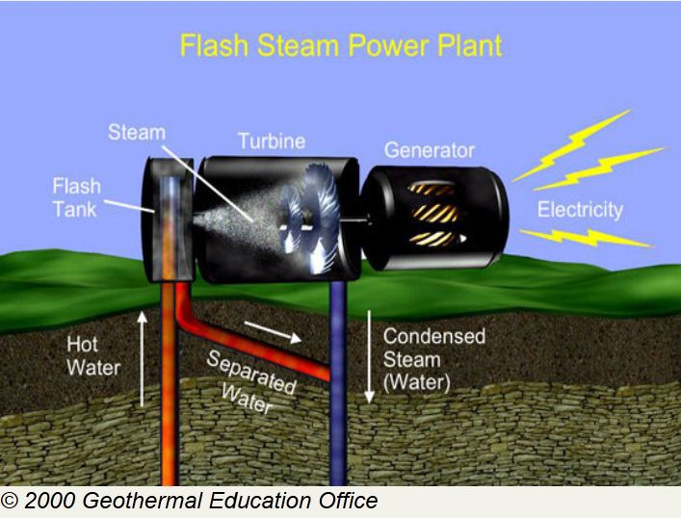
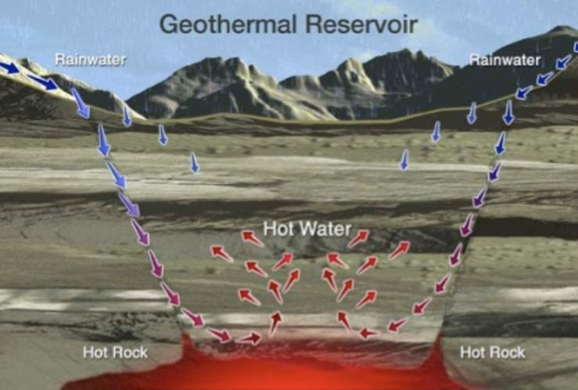
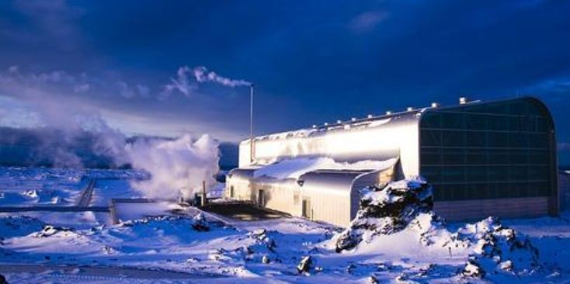
3. Geothermal Electricity Production
Hot water is pumped up from deep geothermal reservoirs several miles below the surface and vaporized.
The resulting high-pressure steam turns a turbine, generating electrical power.
The U.S. leads the world in online geothermal energy with an installed capacity of 3087 MW (4% of our renewable energy production).
LINK 1
LINK 2
Notes:
Most geothermal electric plants are industrial in size, yet small-scale plants (under 5 megawatts) have the potential for widespread application
in rural areas where heat sources over 300°F exist (mostly in western states).
A vast majority of the world’s power production involves the use of hot water. Sources like nuclear, coal and natural gas harness different processes (i.e. radioactive decay, combustion) to heat water into steam, which is run through a turbine to generate electricity. Geothermal energy uses the escaping heat from Earth’s core as a means to heat water and produce electricity. By drilling deep into the Earth’s interior, we find temperatures suitably high to produce electricity.
Sometimes when we drill deep, there is hot water where the rock is porous (has space for fluids). In this case, we can extract the water from depth and through specialized equipment, use it to produce electricity (explained further on). If there is no water, but the rocks are very hot where we drill, it is possible to inject water to create an enhanced geothermal system (EGS) and hot water where it did not exist before. By using Earth’s thermal energy to heat water instead of processes with harmful by-products like coal and nuclear, geothermal energy can produce clean, reliable electricity as long as heat continues to seep from Earth’s interior (as it has for 4.5 billion years). Further, it is sustainable power because once we have extracted the thermal energy from the water or steam, it can be continuously re-injected deep underground to obtain more geothermal heat. (http://www.cangea.ca)
Research and development is underway to use old oil and gas wells for efficiently accessing geothermal energy sources.
LINK 1 goes to the Canadian Geothermal Energy Association
LINK 2 takes you to the American Geothermal Energy Association’s 2010 update report

Slide 18
CalEnergy Electric Plant
Notes:
VIDEO LINK is of a CalEnergy geothermal electric plant. It’s a 5 minute animated explanation.

Slide 19
U.S. Geothermal Potential
(Insufficient data
for HI & AK)
LINK
Notes:
This map identifies deep geothermal reserves needed for electricity production and some direct-use geothermal. Yet clarify to students that all regions of the country are suitable for geoexchange and shallow direct-use systems. We will be focusing on geoexchange.
Point out your state on the map for those students who may not know and identify your region’s potential.
Click on the link below the key/legend for a larger view of the map.

Slide 20
GEOTHERMAL ADVANTAGES
Efficient & Cost Effective – Provides 3 to 4 units of energy for every one unit used to power the system. Potential savings of 80% over electric/gas costs
Clean Renewable Energy – Working with nature, not against it, minimizes threats of pollution and global climate change
Available Everywhere – subterranean temperatures remain relatively constant throughout the U.S.
Low Maintenance – long lasting components that only require periodic checks and filter changes
Scalable – systems can range in size from small residential systems to commercial
Notes:
Efficiency – More than 3 times as efficient as conventional systems. Geothermal systems are efficient, environmentally-sensitive, comfortable, and economical. Operating savings often provide paybacks of considerably less than five years -- sometimes less than two years. In addition, electric utilities are so convinced of the value of this technology for their customers that they offer design assistance, referrals, or financial incentives to defray the first cost increment of geothermal systems. The key is that geothermal heat pumps use electricity to move heat, not to generate it by the burning fuel or using electric resistance elements. Indeed, the U.S. EPA has found that no other technology with more favorable operating efficiencies and economics than emerging geothermal heat and cooling systems.
The heating efficiency of ground-source and water-source heat pumps is indicated by their coefficient of performance (COP), which is the ratio of heat provided in Btu per Btu of energy input. Their cooling efficiency is indicated by the Energy Efficiency Ratio (EER), which is the ratio of the heat removed (in Btu per hour) to the electricity required (in watts) to run the unit. Look for the ENERGY STAR® label, which indicates a heating COP of 2.8 or greater and an EER of 13 or greater.
Manufacturers of high-efficiency geothermal heat pumps voluntarily use the EPA ENERGY STAR label on qualifying equipment and related product literature. If you are purchasing a geothermal heat pump and uncertain whether it meets ENERGY STAR qualifications, ask for an efficiency rating of at least 2.8 COP or 13 EER.
Many geothermal heat pump systems carry the U.S. Department of Energy (DOE) and EPA ENERGY STAR label. Ask your contractor about special financing or incentives for purchasing energy efficient products, including ENERGY STAR qualified products.
An Important Renewable Energy Technology The U.S. Environmental Protection Agency has concluded that well-designed and properly installed high efficiency geothermal heat pump systems produce less environmental harm than any other alternative space conditioning technology currently available. On a full fuel cycle basis, emerging geothermal systems are the most efficient technology available, with the lowest CO2 emissions for minimum greenhouse warming impact. Overall, the EPA found emerging geothermal heating and cooling systems to have the lowest environmental cost of all technologies analyzed -- including air-source heat pumps and natural gas furnaces.
Readily available - subterranean temperatures remain relatively constant throughout the U.S. (55 degrees F average).
Maintenance - System life is estimated at 25 years for the inside components and 50+ years for the ground loop. Geothermal systems are practically maintenance free. When installed properly, the buried loop will last for generations. And the other half of the operation—the unit's fan, compressor, and pump—is housed indoors, protected from the harsh weather conditions. Usually, periodic checks and filter changes are the only required maintenance.
Geothermal Heat Pump Systems Work! No existing space conditioning technology offers greater comfort, economy, or environmental benefits than the geothermal heat and cooling systems now available for residential and commercial installations. Over 250,000 installations are in place in the United States today, and the number is rapidly increasing.

Slide 21
Pros and Cons of Geothermal
Notes:
Advantage Disadvantage Geothermal
The Advantage Disadvantage Geothermal table shows the pros of geothermal energy and some geothermal energy disadvantages.
Advantages of Closed Loop Refrigerant Geothermal Systems
There are several advantages of closed loop geothermal heatpump systems over open loop systems. There are also advantages to the systems that use refrigerant in these loops over the systems that use antifreeze or water in the loops.
Advantages of Refrigerant Ground Loop Systems
Refrigerant ground loop geothermal systems are usually more efficient than water-based loop systems.
They require a smaller length of buried pipes.
They do not have problems with the exposed parts of the pipes freezing
They have a higher degree of heat transfer.
Disadvantages of Open Ground Loop Geothermal Systems
In a closed-loop system, the same refrigerant or water circulates through the pipes repeatedly. In an open-loop system, water is pumped out of the water source, such as a well or a man-made lake, and when the heat has been extracted from the water, that water returns to the well or surface lake.
Open loop systems are generally not recommended for the following reasons.
Higher maintenance costs.
Open loop systems continually bring water in from outside the system. This can lead to mineral build up and corrosion throughout the geothermal system as well as a potential for clogging.

Slide 22
Discussion
What are some pros and cons
of geothermal energy?
Notes:
Efficiency – More than 3 times as efficient as conventional systems. Geothermal systems are efficient, environmentally-sensitive, comfortable, and economical. Operating savings often provide paybacks of considerably less than five years -- sometimes less than two years. In addition, electric utilities are so convinced of the value of this technology for their customers that they offer design assistance, referrals, or financial incentives to defray the first cost increment of geothermal systems. The key is that geothermal heat pumps use electricity to move heat, not to generate it by the burning fuel or using electric resistance elements. Indeed, the U.S. EPA has found that no other technology with more favorable operating efficiencies and economics than emerging geothermal heat and cooling systems.
The heating efficiency of ground-source and water-source heat pumps is indicated by their coefficient of performance (COP), which is the ratio of heat provided in Btu per Btu of energy input. Their cooling efficiency is indicated by the Energy Efficiency Ratio (EER), which is the ratio of the heat removed (in Btu per hour) to the electricity required (in watts) to run the unit. Look for the ENERGY STAR® label, which indicates a heating COP of 2.8 or greater and an EER of 13 or greater.
Manufacturers of high-efficiency geothermal heat pumps voluntarily use the EPA ENERGY STAR label on qualifying equipment and related product literature. If you are purchasing a geothermal heat pump and uncertain whether it meets ENERGY STAR qualifications, ask for an efficiency rating of at least 2.8 COP or 13 EER.
Many geothermal heat pump systems carry the U.S. Department of Energy (DOE) and EPA ENERGY STAR label. Ask your contractor about special financing or incentives for purchasing energy efficient products, including ENERGY STAR qualified products.
An Important Renewable Energy Technology The U.S. Environmental Protection Agency has concluded that well-designed and properly installed high efficiency geothermal heat pump systems produce less environmental harm than any other alternative space conditioning technology currently available. On a full fuel cycle basis, emerging geothermal systems are the most efficient technology available, with the lowest CO2 emissions for minimum greenhouse warming impact. Overall, the EPA found emerging geothermal heating and cooling systems to have the lowest environmental cost of all technologies analyzed -- including air-source heat pumps and natural gas furnaces.
Readily available - subterranean temperatures remain relatively constant throughout the U.S. (55 degrees F average).
Maintenance - System life is estimated at 25 years for the inside components and 50+ years for the ground loop. Geothermal systems are practically maintenance free. When installed properly, the buried loop will last for generations. And the other half of the operation—the unit's fan, compressor, and pump—is housed indoors, protected from the harsh weather conditions. Usually, periodic checks and filter changes are the only required maintenance.
Geothermal Heat Pump Systems Work! No existing space conditioning technology offers greater comfort, economy, or environmental benefits than the geothermal heat and cooling systems now available for residential and commercial installations. Over 250,000 installations are in place in the United States today, and the number is rapidly increasing.

Slide 23
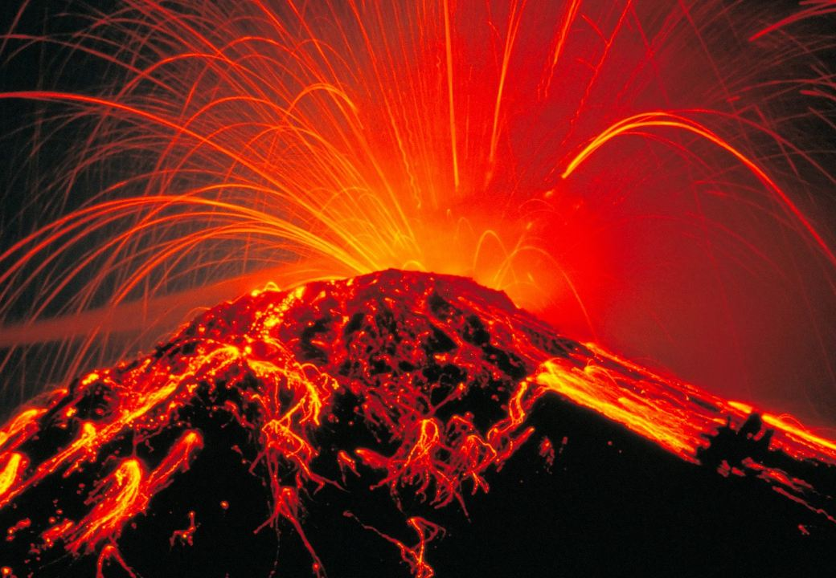
Discussion
Which technology do you feel
is most efficient, practical and
readily available in your area?
Notes:
From here on out we will be focusing on Geothermal Heat Pumps, as they are generally the most cost-effective avenue for energy efficiency on farms and can be most easily installed.
Reasons for this selection:
Geothermal electric production is still at an industrial scale and limited to few states out west.
Direct-use applications require drilling into reservoirs, often several miles deep. None the less, large Ag operations can save considerable energy and extend their growing season by using this resource where available.

Slide 24
2: Geothermal Heat Pumps
Horizontal Loop
Vertical Loop
Pond Loop
Open Loop
Hybrid Designs

Slide 25
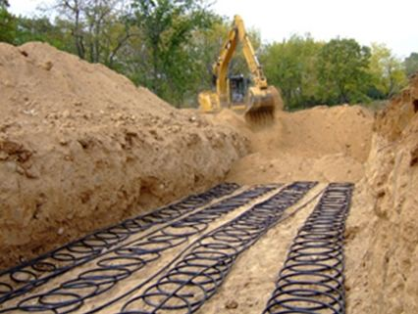
Geothermal Heat Pumps (GHPs)
A Geoexchange technology, Geothermal Heat Pumps can heat and cool water and forced-air for homes, barns & livestock enclosures.
Dual-Purpose: Heat a barn while cooling crop storage sheds
Water or an anti-freeze fluid is circulated in a closed-loop system of pipes through the ground and into buildings using a heat pump.
Notes:
Almost everywhere, the shallow ground of the Earth's surface maintains a nearly constant temperature (averaging 55°F). Geothermal heat pumps can tap into this resource to heat and cool buildings.
In winter, a fluid circulating through pipes buried in the ground absorbs heat from the earth and carries it into the home. The Geoexchange system inside the home uses a heat pump to concentrate the earth's thermal energy and then to transfer it to the interior space for warmth.
In the summer, the process is reversed: heat is extracted from the air in the house and transferred through the heat pump to the ground loop piping. The fluid in the ground loop then carries the heat back to the earth. The only external energy needed for Geoexchange is the small amount of electricity needed to operate the heat pump, ground loop pump and distribution fan or pump.

Slide 26
Geoexchange Video
Notes:
The link above is to a 2 ½ minute YouTube video explaining the basics of geoexchange systems (http://www.youtube.com/watch?v=y_ZGBhy48YI)

Slide 27
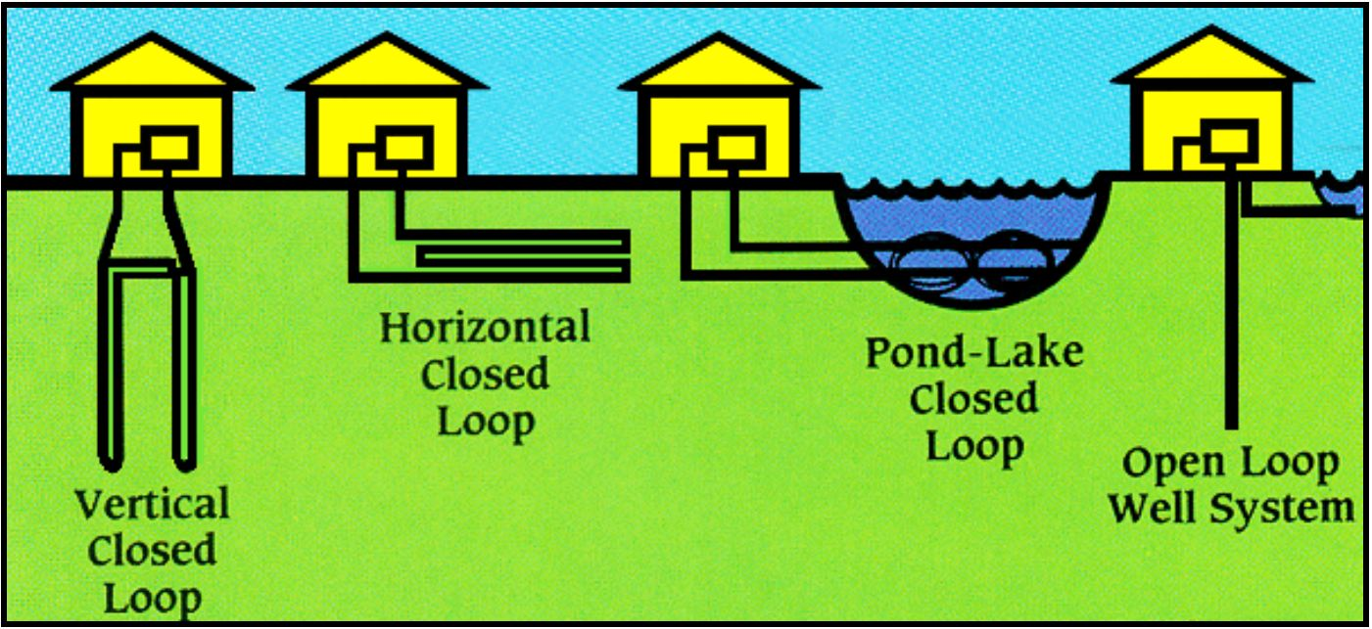
Geothermal Heat Pump Designs
1) Vertical loop
2) Horizontal loop
Pond loop
4) Open loop
Notes:
Soil Characteristics
It is important to note that the ground loop (source) must be matched for the equipment selected. The soil conditions determine the system's heat transfer capability. Heavy soil performs better than lighter soils. Moisture content is also a factor. Saturated soils perform better than dry or moist soils.
Flow characteristics
Also important in the design of the loop is flow characteristics. The flow of liquid within a pipe can be considered either Laminar, with the fluid molecules traveling in a straight line, or turbulent, where mixing occurs. The best heat transfer occurs when the flow is turbulent.
Air in the pipes
Because the ground loop is connected under ground or water, the design must also include the ability to flush the air out of the pipes while filling.
The heating/cooling sustainability
The heating/cooling sustainability, of a properly sized ground loop can last indefinably due to the fact that 47% of the suns energy that reaches the Earth is absorbed. This combined with air conditioning (cooling) that injects heat back into the loop will be close to the same earth temperature as first installed or can even be higher if a large air conditioning (cooling) load is present.
Challenges: The challenges with the geothermal technology is in converting the practicing of old technologies (oil, gas) and adopting the new technologies as the standard. Also being that the geothermal industry is relatively new (25 years) there is a shortage of qualified engineers and trades people to support mass deployment at this time.

Slide 28
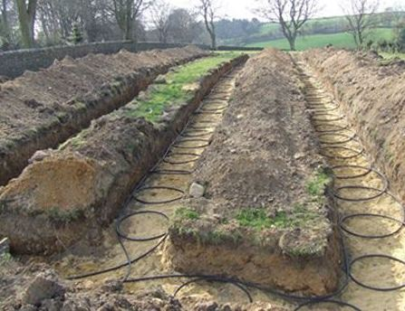
1. Horizontal Loop
Polyethylene pipes are coiled flat and backfilled
Needs more land than other designs
Best suited for non-rocky soils
Trenches can be dug with smaller equipment (DIY)Cost effective
Approx. 250’ of trench per 10,000 BTU/HR
Approx. 7’ deep with 2’ spacing in heavy soil
Notes:
Horizontal systems require more land but are generally ideal for farms as they are more cost-effective, especially self-installed. Horizontal loops involve trenches that are dug using a backhoe, track hoe or chain trencher. Horizontal directional boring is also an option. Polyethylene pipes/tubes are inserted and the trenches are backfilled. Some types of horizontal boring have to be grouted to ensure pipe contact with the surrounding ground. About 250 ft of trench/per 10,000 BTU/HR (heating), (7 ft depth, 2 pipe configuration with 2 foot spacing and heavy damp soil).
A horizontal loop is usually the most cost effective when adequate yard space is available and trenches are easy to dig. Using trenchers or backhoes digging trenches three to six feet below the ground, you then lay a series of parallel plastic pipes.
The trench is then back filled, taking care not to allow sharp rocks or debris to damage the pipe. A typical horizontal loop will have 400-600 feet of pipe per ton of heating and cooling capacity. The land area required for horizontal ground loops will range from 1500-3000 square feet per ton of heating/cooling depending on soil properties and earth temperatures.

Slide 29
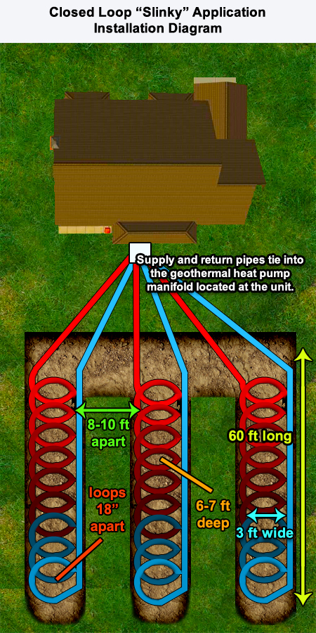
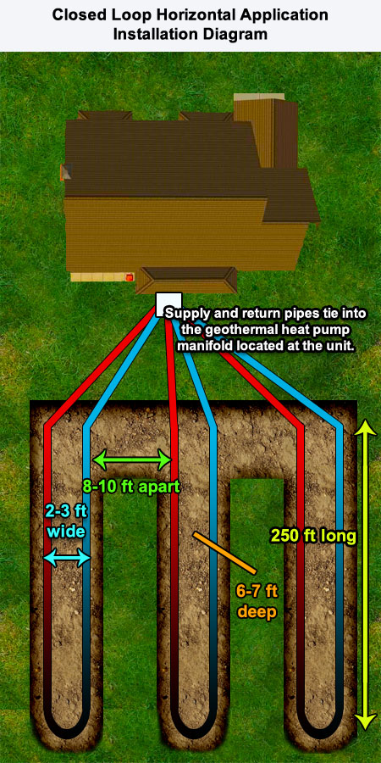
Types of Horizontal Loops
Notes:
Horizontal Loops can either be laid straight or in “slinky” loops, as shown above.

Slide 30
Ground Loop Installation
Notes:
This YouTube video offers a good explanation of the installation process for ground loop systems. The company’s add is at the end so you can end it at 2:45 min.

Slide 31
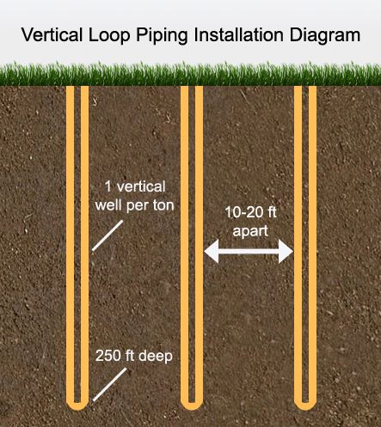
2. Vertical Loop
Long pipe loops are set into vertical
holes 50-500’ deep and backfilled
Minimal land needed
Well-drilling equipment required
~200’ of bore per 10,000 BTU/HR
Suitable for rocky & heavy soils
More expensive but more efficient
(temps. are more stable further down)
400-600’ of borehole (150-300 sq ft
of land) per system-ton of heating/cooling
Rebar cage surround 120 linear feet of HDPE (high density polyethylene) to be lowered into vertical shafts.
Notes:
Vertical loops are used where space is limited and soils are heavy. Approx. 200 ft of bore per 10,000 Vertical loops are used when space is limited and, or soil disturbance is a problem. Holes are bored using a drill rig. A pair of pipes with special u-bend fittings are inserted into the holes. The holes are sealed with a grout. About 200 feet of bore/per 10,000 BTU/HR (heating), (heavy saturated soil conditions).
This type of loop is used where there is little yard space, when surface rocks make digging impractical, or when you want to disrupt the landscape as little as possible.
Vertical holes 100 to 500 feet deep - much like wells - are bored in the ground, and single or multiple loops of pipe with a U-bend at the bottom is/are inserted before the hole is backfilled. Each vertical pipe is then connected to a horizontal underground pipe that carries fluid in a closed system to and from the indoor exchange unit.
Vertical loops are generally more expensive to install, but require less piping than horizontal loops because the Earth's temperature is more stable farther below the surface. Typical piping requirements range from 400-600 feet of borehole per system ton of heating cooling, depending (as always) on the soil properties and ground temperature conditions. This requirement usually results in 1-2 boreholes per ton of system load, again, the exact requirement being dictated by the thermal properties of the soil.
An important design factor is the spacing between boreholes. A rule of thumb is that boreholes should be 15-20 feet apart to avoid having the thermal conductivity of the boreholes conflicting with each other. Vertical ground loops typically require 150-300 square feet of land area per system ton of heating/cooling capacity. (www. earthrivergeo.com)

Slide 32
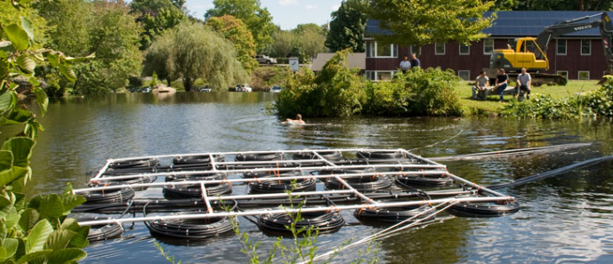
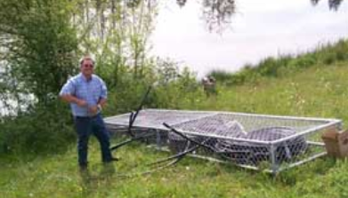
3. Pond Loop
Coiled pipes are submerged 6+ feet
Affordable design, Minimal digging (DIY)
Requires at least 10 feet of water
Approx. 300 linear feet of piping per system-ton of heating/cooling
Piping installed in frames
Piping installed in baskets
Pond loop system before being submerged
Notes:
A pond loop consists of a series of closed loops coiled or slinky style, to be sunk to the bottom of an adequately sized body of water.
Submerged-loop systems typically require about 300 linear feet of piping per system ton. Depending on the pond depth ponds can support GHP systems ranging from 15 to 85 tons per acre of pond surface area. This range corresponds to a unit area requirement of 500 to 3,000 square feet per system ton. The minimum acceptable pond depth for submerged ground loops is 10 feet.
Concrete anchors are used to secure the piping coils, preventing their movement and holding the coils 9 to 18 inches above the pond floor, to allow good convective circulation of water around the piping. It also is recommended that the coils be submerged at least 6 feet below the pond surface (accounting for the lowest depth of the year), preferably deeper, in order to maintain adequate thermal mass in times of extended drought or other low-water conditions.
Pond loops are a special kind of closed loop system. Geothermal transfer fluid is pumped just as a closed loop ground system. First cost economics are very attractive and there is no aquatic environmental impact.

Slide 33
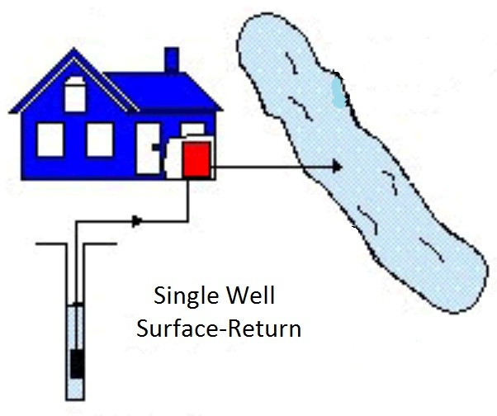
4. Open Loop
Unlike other designs, Open Loop uses a constant supply
of groundwater for heat exchange. Used water is injected
into another well or disposed of above ground.
VIDEO
LINK
Requires an abundant supply of groundwater
Well water must be at least 43°F
Drilling required but minimal piping needed
2-3 gal/min of water needed per ton of
heating/cooling capacity (ex: 12 gal/min for
3000 sq ft home)
May pose environmental concerns due to
extensive water usage
Systems using an existing well start at $15,000)
VIDEO LINK
Notes:
An open loop is used where there is an abundant supply of quality well water. Used water can be discharged on the surface or returned into the ground. If two wells are used, the spacing between wells should be approximately 100 feet. 2 US/GPM @ 44 deg/F per/10,000 BTU/HR. The well supply should be more than required in case the production of the well drops over time. The ground water temperature should also be a minimum temperature of 6 degrees Celsius.
The VIDEO LINK in the top right corner explains open loop systems in a 3 minute YouTube video. The first 40 seconds can be skipped.

Slide 34
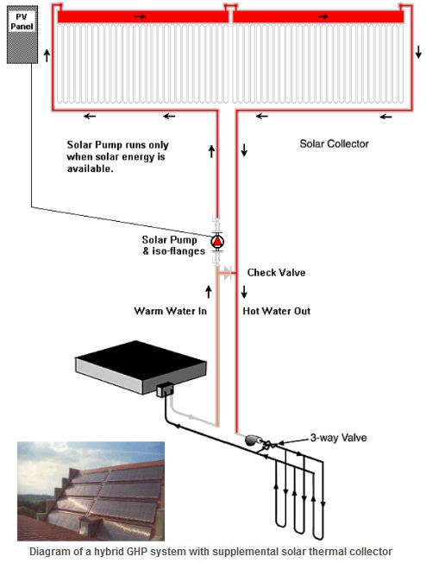
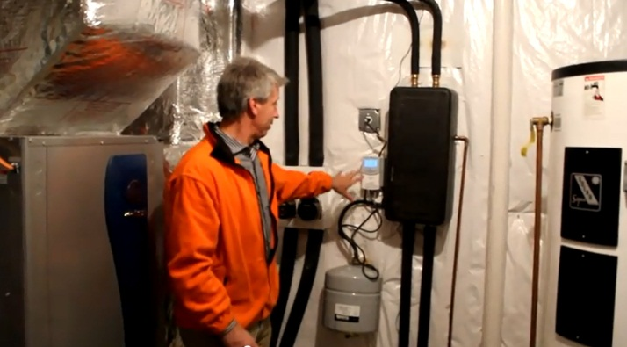
Hybrid Designs
Heat Pumps can be
supplemented with
solar thermal
heating systems.
Notes:
The LINK above is to a 6 minute video that provides a detailed look at the mechanics of a solar thermal – geothermal hybrid system. You can skip the first 2 minutes of discussion if you want to simply show an explanation of the set-up.
Hybrid Loop with Solar Collector
For GHP systems being designed for colder weather parts of the U.S. heating load might be the driving ground loop design factor. In such cases, supplementing a GHP system with solar thermal collectors will reduce the required size of the ground loop and increase heat pump efficiency by providing significantly higher building loop temperatures than could be attained by the ground heat exchanger alone. In most cases, the solar thermal collector can be connected directly to the ground loop, as shown.
A liquid/liquid isolation heat exchanger would be required, however, if the solar re-circulating loop needs a different level of antifreeze protection than the ground loop or uses a different antifreeze additive.
Solar thermal collectors almost always use propylene glycol for both antifreeze and anti-boiling protection, whereas methanol is the preferred antifreeze additive for closed ground loops, where environmental and health regulations permit its use.

Slide 35
Hybrid Designs Video

Slide 36
Pop Quiz!
What are the four types of geothermal heat pumps?
Notes:
Answer on next slide, along with a discussion question.

Slide 37
Discussion
Which design would you use?
Notes:
Ask students to explain why they would choose each of the designs, explaining their property characteristics and how they would use the GHP energy.
Ask around until each of the four designs have been represented.

Slide 38
3: GHP Subsystems
Earth Connector
Heat Transfer Unit
Distribution System
Water Heating
Efficiency & Versatility

Slide 39
Geothermal Heat Pump Subsystems
1. Earth Connection
2. Heat Transfer Unit
3. Distribution System
Notes:
These are the three main components of a GHP, as explained in the following slides.

Slide 40
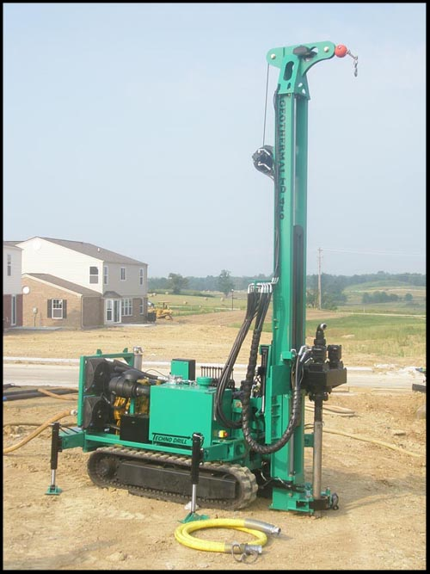
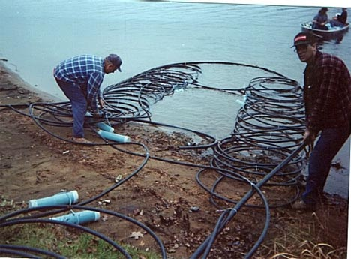
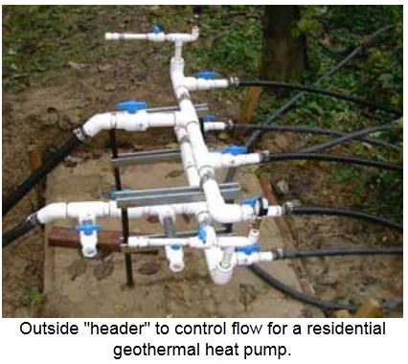
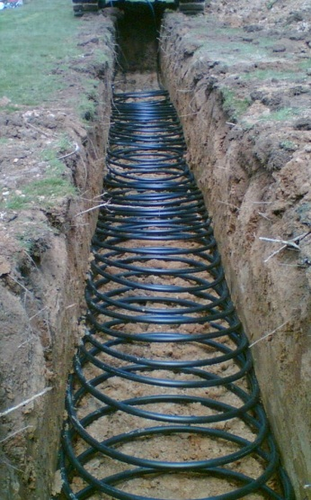
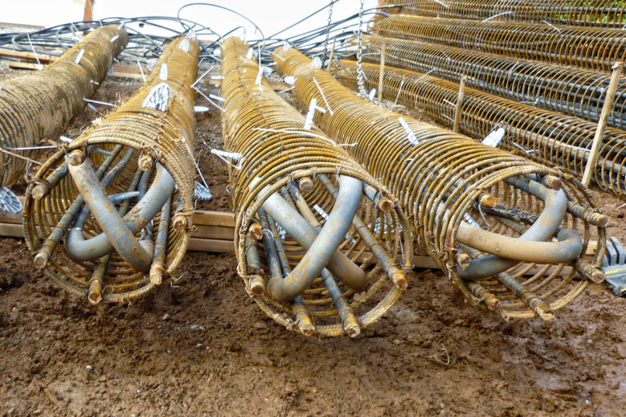
1. Earth Connection Subsystem
Geothermal systems can transfer and deliver heat in
a variety of ways.
Plastic or metal pipes can be inserted in the ground or submerged under water.
Notes:
Geothermal Earth Connection Subsystem
Using the Earth as a heat source/sink a connection is made between the object (building..) which is to be heated/cooled and the earth. This earth connection is generally in the form of pipes or tubes that can transfer heat through its walls. It is the path taken by the earth connection between its beginning and its final return that is most important.
In reality, it is nothing more than a refrigerator that can be reversed. In warm weather the geothermal unit acts like your home refrigerator. It removes unwanted heat from the space being cooled and deposits that unwanted heat somewhere else, in this case to the earth. In cool weather the geothermal heat pump acts as a reverse refrigerator because it withdraws heat from the earth and transfers that earth heat into the space being heated.

Slide 41
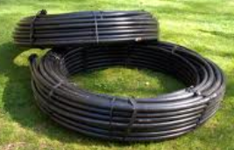
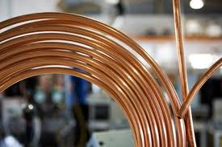
Piping Options
Plastic piping is less expensive, yet copper Direct Expansion (DX) systems act like a large condenser and have numerous
ADVANTAGES:
Copper provides better conductivity
Less piping and smaller bore-holes
Ideal for areas with limited space
Fewer components needed
DISADVANTAGES:
Toxic refrigerant solution
Higher cost of copper piping
Copper may not hold up in some soils
Newer technology – possible design flaws
Notes:
Advantages of DX Systems over Other Geothermal Systems
Direct expansion (DX) ground source heat pumps (GSHP) have the heat pump refrigerant run through the earth coil which acts like a large condenser, eliminating the need for the water/antifreeze solution, the extra pump, and the heat exchanger. These DX systems use ground coils made of copper tubing and tend to be more efficient, since there is no heat exchanger and because copper provides better conductivity than the plastic pipe used in most other systems. Heat is transferred directly between the refrigerant and the ground, and the amount of piping can be reduced. This type of system is ideal for situations where the amount of space for the piping loop is very limited. The copper loops contain a refrigerant as opposed to the intermediate transfer fluid of plastic systems, which also require a circulating pump. Generally DX system earth loops require a much smaller borehole for vertical and diagonal loop installations. System start-up does not require a purging cart, the addition of antifreeze, or other tasks associated with water loop systems. On the refrigerant side, factory-assembled earth loops are usually brazed to pre-fabricated manifolds, further simplifying installation.
Disadvantages of DX Systems
One of the disadvantages is the higher cost of copper piping, although savings from shorter loops, etc., may help offset this. Other disadvantages are the durability of copper in some soil types and the difficulty of repairing refrigerant leaks in buried pipes. Generally, leaking DX ground loops must be abandoned and refrigerant reclaimed. Significant problems were reported with early installations of DX systems (Energy Design Update, September 1994), showing the importance of evaluating any product's track record in the field.

Slide 42
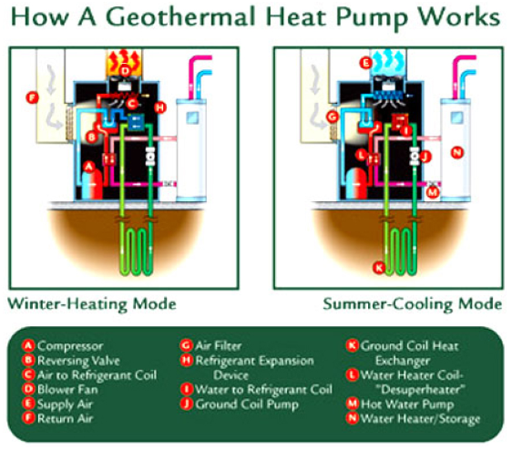
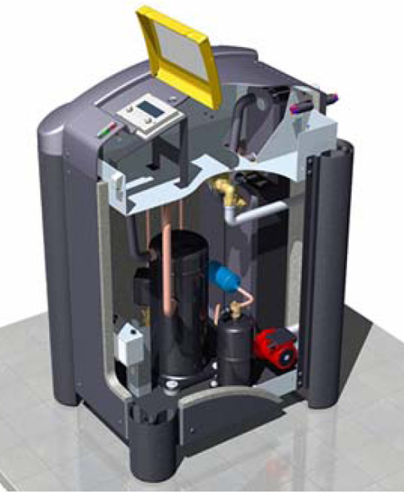
2. Heat Transfer Subsystem
A geothermal heat pump (transfer unit) includes:
Loop-to-Refrigerant, Heat Exchanger, Compressor & Controls
Notes:
Geothermal Heat Pump
The geothermal heat pump is packaged in a single cabinet, and includes the compressor, loop-to-refrigerant heat exchanger, and controls. Systems that distribute heat using ducted air also contain the air handler, duct fan, filter, refrigerant-to-air heat exchanger, and condensate removal system for air conditioning. For home installations, the geothermal heat pump cabinet is usually located in a basement, attic, or closet. In commercial installations, it may be hung above a suspended ceiling or installed as a self-contained console.
SPECS: Heat pumps use a vapor compression cycle to transport heat from one location to another.
In heating mode, the cycle starts as the cold liquid refrigerant within the heat pump which passes through a heat exchanger (evaporator) and then absorbs heat from the fluid circulated through the earth connection [See I in diagram above].
The refrigerant evaporates into a gas as heat is absorbed from the earth connection heat exchanger (evaporator). The gaseous refrigerant then passes through a compressor [See A in diagram above] where it is pressurized, raising its temperature to over 180 degrees F.
The hot gas then circulates through a refrigerant-to-air heat exchanger [See C in diagram above] where the heat is removed and sent through the air ducts. When the refrigerant loses the heat, it changes back to a liquid. The liquid refrigerant cools as it passes through an expansion valve [See H in diagram above] and the process begins again.
The heating description above is for a system with a forced air/ductwork distribution system, the most common geothermal application.

Slide 43
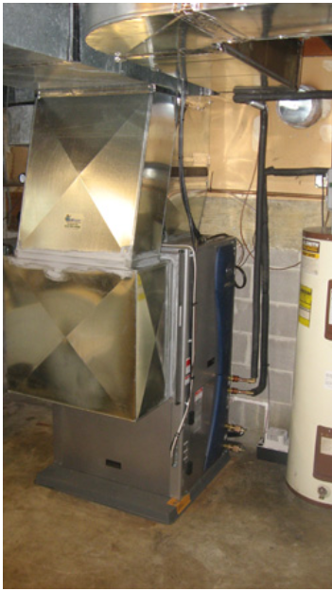
3. Distribution Subsystem
Forced Air Ductwork
Radiant In-Floor Heating
Baseboard Heating
Fan Coil Units
Systems that distribute heat using ducted
air also contain the air handler, duct fan,
filter, refrigerant-to-air heat exchanger,
and condensate removal system for AC.
Notes:
Conventional ductwork is generally used to distribute heated or cooled air from the geothermal heat pump throughout the object being cooled/heated. However other approaches to heat distribution have also been successfully employed. These include a wide variety of distribution systems including: radiant floor, cast iron radiators, baseboard, and fan coils.
ADDITIONAL INFO:
Most residential geothermal systems use conventional ductwork to distribute hot or cold air and to provide humidity control. (A few systems use water-to-water heat pumps with one or more fan-coil units, baseboard radiators, or under-floor circulating pipes.) Properly sized, constructed, and sealed ducts are essential to maintain system efficiency. Ducts must be well insulated and, whenever possible, located inside of the building's thermal envelope (conditioned space). Geothermal heating and cooling systems for large commercial buildings, such as schools and offices, often use a different arrangement. Multiple heat pumps (perhaps one for each classroom or office) are attached to the same earth connection by a loop inside the building. This way, each area of the building can be individually controlled. The heat pumps on the sunny side of the building may provide cooling while those on the shady side are providing heat. This arrangement is very economical, as heat is merely being transferred from one area of the building to another, with the earth connection serving as the heat source or heat sink only for the difference between the building's heating and cooling needs. (http://fli.hws.edu)

Slide 44
Pop Quiz!
What are the three main
subsystems of a GHP?
Notes:
Earth Connection
Heat Transfer
Distribution

Slide 45
Geoexchange Water Heating
Desuperheater :
A secondary heat exchanger that transfers heat from a ground-loop system to a domestic hot water tank with
3 times the efficiently of conventional systems.
Notes:
Water heating is one of the most effient uses of geothermal energy.
Geothermal systems may also be equipped with a device called a "desuperheater". A desuperheater-equipped heat pump can heat water 2 to 3 times more efficiently than an ordinary electric water heater A desuperheater can heat household water, which circulates into the regular water heater tank. In the summer, heat that is taken from the house and would be expelled into the loop is used to heat the water for free. In the winter, the desuperheater can reduce water-heating costs by about half, while a conventional water heater meets the rest of the household's needs. In the spring and fall when temperatures are mild and the heat pump may not be operating at all, the regular water heater provides hot water.
MORE INFO: Many residential-sized systems installed today are equipped with desuperheaters to provide domestic hot water when the system is providing heat or air conditioning. The desuperheater is a small auxiliary heat exchanger at the compressor outlet. It transfers excess heat from the compressed gas to a water line that circulates water to the house's hot water tank. In summer, when the air conditioning runs frequently, a desuperheater may provide all the hot water needed by a household. It can provide four to eight gallons of hot water per ton of cooling capacity each hour it operates. A desuperheater provides less hot water during the winter, and none during the spring and fall when the system is not operating.
Because the heat pump is so much more efficient than other means of water heating, manufacturers are beginning to offer "triple function," "full condensing," or "full demand" systems that use a separate heat exchanger to meet all of a household hot water needs. These units cost-effectively provide hot water as quickly as any competing system.
http://www.youtube.com/watch?v=eJ3JtKjLX1Q

Slide 46
Efficiency & Versatility
Geoexchange use some of the most advanced efficiency technologies.
2-Speed Dual Compressors Scroll Compressor Dual Source Heat Pump
Notes:
A geothermal system is more than 3 times as efficient as the most efficient conventional system. Because geothermal systems do not burn combustible fuel to make heat, they provide 3 to 4 units of energy for every one unit used to power the system. 600% energy efficiency can be attained in the winter with geothermal heat pumps, compared to ~250% efficiency for air-source heat pumps.
GeoExchange systems are so efficient that the U.S. EPA has said they are, "the most energy-efficient, environmentally clean, and cost-effective space conditioning systems available today". (www.geoexchange.org)
Studies show that approximately 70% of the energy used in a geothermal heat pump system is renewable energy from the ground. The earth's constant temperature is what makes geothermal heat pumps one of the most efficient, comfortable, and quiet heating and cooling technologies available today. While they may be more costly to install initially than regular heat pumps, they can produce markedly lower energy bills - 30 percent to 40 percent lower, according to estimates from the U.S. Environmental Protection Agency, who now includes geothermal heat pumps in the types of products rated in the EnergyStar® program. Because they are mechanically simple and outside parts of the system are below ground and protected from the weather, maintenance costs are often lower as well.
As an added benefit, systems can be equipped with a device called a "desuperheater" can heat household water, which circulates into the regular water heater tank. In the summer, heat that is taken from the house and would be expelled into the loop is used to heat the water for free. In the winter, the desuperheater can reduce water-heating costs by about half, while a conventional water heater meets the rest of the household's needs. In the spring and fall when temperatures are mild and the heat pump may not be operating at all, the regular water heater provides hot water.
Variable Speed Efficiency –
Unlike standard compressors that can only operate at full capacity, two-speed compressors allow heat pumps to operate close to the heating or cooling capacity that is needed at any particular moment. This saves large amounts of electrical energy and reduces compressor wear. Two-speed heat pumps also work well with zone control systems. Zone control systems, often found in larger homes, use automatic dampers to allow the heat pump to keep different rooms at different temperatures.
Some models of heat pumps are equipped with variable-speed or dual-speed motors on their indoor fans (blowers), outdoor fans, or both. The variable-speed controls for these fans attempt to keep the air moving at a comfortable velocity, minimizing cool drafts and maximizing electrical savings. It also minimizes the noise from the blower running at full speed.
Many high-efficiency heat pumps are equipped with a desuperheater, which recovers waste heat from the heat pump's cooling mode and uses it to heat water. A desuperheater-equipped heat pump can heat water 2 to 3 times more efficiently than an ordinary electric water heater.
Another advance in heat pump technology is the scroll compressor, which consists of two spiral-shaped scrolls. One remains stationary, while the other orbits around it, compressing the refrigerant by forcing it into increasingly smaller areas. Compared to the typical piston compressors, scroll compressors have a longer operating life and are quieter. According to some reports, heat pumps with scroll compressors provide 10°–15°F (5.6°–8.3°C) warmer air when in the heating mode, compared to existing heat pumps with piston compressors.
Although most heat pumps use electric resistance heaters as a backup for cold weather, heat pumps can also be equipped with burners to supplement the heat pump. Back-up burners help solve the problem of the heat pump delivering relatively cool air during cold weather and reduces its use of electricity. Since there are few heat pump manufacturers that incorporate both types of heat supply in one box, these configurations are often two smaller, side-by-side, standard systems sharing the same ductwork. The combustion fuel half of the system could be propane, natural gas, oil, or even coal and wood.
Dual-source heat pumps combines an air-source heat pump with a geothermal heat pump. These appliances combine the best of both systems. Dual-source heat pumps have higher efficiency ratings than air-source units, but are not as efficient as geothermal units. The main advantage of dual-source systems is that they cost much less to install than a single geothermal unit, and work almost as well.
SOURCE: http://www.energysavers.gov/your_home/space_heating_cooling/index.cfm/mytopic=12700

Slide 47
4: Project Development
Site Considerations/Sizing
Cost/Installation/Maintenance
Economics/Funding
Data Systems
Additional Resources

Slide 48
Project Development
Site Considerations
System Sizing
Cost, Installation &
Maintenance
Economics
Data Systems
Feasibility Studies
Additional Resources

Slide 49
Site Selection
Geology - soil and rock composition can affect heat transfer rates
Hydrology – Water availability, depth, volume, and quality will determine your options
Land Availability - The amount/layout of your land and location of underground utilities also contribute to your system design
Q: How might the above factors affect your geothermal options? Give design examples.
Notes:
ACTIVITY: Have students break into small groups and come up with several design considerations regarding limits posed by geology, hydrology and land availability. Ask them to come up with examples of particular designs and why they would use them under certain situations. You can return to slide 15 so they can see the 4 designs we have been discussing.
Evaluating Your Site for a Geothermal Heat Pump
Because shallow ground temperatures are relatively constant throughout the United States, geothermal heat pumps (GHPs) can be effectively used almost anywhere. However, the specific geological, hydrological, and spatial characteristics of your land will help your local system supplier/installer determine the best type of ground loop for your site:
Geology
Factors such as the composition and properties of your soil and rock (which can affect heat transfer rates) require consideration when designing a ground loop. For example, soil with good heat transfer properties requires less piping to gather a certain amount of heat than soil with poor heat transfer properties. The amount of soil available contributes to system design as well — system suppliers in areas with extensive hard rock or soil too shallow to trench may install vertical ground loops instead of horizontal loops.
Hydrology
Ground or surface water availability also plays a part in deciding what type of ground loop to use. Depending on factors such as depth, volume, and water quality, bodies of surface water can be used as a source of water for an open-loop system, or as a repository for coils of piping in a closed-loop system. Ground water can also be used as a source for open-loop systems, provided the water quality is suitable and all ground water discharge regulations are met.
Before you purchase an open-loop system, you will want to be sure your system supplier/installer has fully investigated your site's hydrology, so you can avoid potential problems such as aquifer depletion and groundwater contamination. Antifreeze fluids circulated through closed-loop systems generally pose little to no environmental hazard.
Land Availability
The amount and layout of your land, your landscaping, and the location of underground utilities or sprinkler systems also contribute to your system design. Horizontal ground loops (generally the most economical) are typically used for newly constructed buildings with sufficient land. Vertical installations or more compact horizontal "Slinky™" installations are often used for existing buildings because they minimize the disturbance to the landscape.
SORCE: http://www.energysavers.gov/your_home/space_heating_cooling/index.cfm/mytopic=12670

Slide 50
System Sizing
Electrical System Requirements:
Single-phase power is limited to ~60,000 Btu/h per unit
Three-phase power can handle units up to 462,000 Btu/h
System Size Limits:
Forced air systems can range from 7,600 - 220,000 BTU/HR
Hydronic units range from 5,000 - 462,000 BTU/HR
Land Area Requirements:
Vertical loop: 200-400 sq. ft./10,000 Btu capacity
Horizontal loop: 2,000-4,000 sq. ft./10,000 Btu capacity.
Notes:
GENERAL CONSIDERATIONS: A system sized for 100% of your heating capacity will be over sized for your cooling needs. That means, that in the cooling mode, your unit will be cycling on and off many more times than a system sized to meet 80% of your heating demand. This results in premature wear of the compressor due to unnecessary cycling, but even more importantly, the larger unit will cool your home to the set point before it has lowered the humidity sufficiently. It’s the lowering of the humidity that can have an even greater effect on comfort level than a lower temperature. A unit sized to 80% of the heating capacity is properly sized. The other 20% will come from cooking, lighting, appliances, people, etc.
A force air heat pump should also be backed up by about 15 kilowatts of resistance heating elements mounted in the plenum. This serves two functions. First, should you experience severe heat loss in your home due to cold temperatures and high winds, your heat pump is backed up by an additional 50,000 BTU’s, more than enough to meet your worst case demands. The second reason for the back-up plenum heater is so that you have a ‘Plan B’ should your compressor fail on a long, holiday weekend. The smaller system will also be substantially less expensive, considering the major cost of any geothermal installation is drilling.

Slide 51
Project Planning Resources
HYPERLINKS:
Dept. of Energy Data and Resources
Preliminary Assessment
Exploring Ways to Use Geothermal Energy
Geothermal Technologies Program
Geothermal Energy Basics
Geothermal Energy
GeoExchange
Geo-Heat Center
Software for ground loop design analysis:
http://www1.eere.energy.gov/calculators/buildings.html
www.retscreen.net (free Canadian software)
www.groundloopdesign.com (free trial software available)
Notes:
Activity/Homework Assignment: Have students use these softeare programs to design a geothermal system and identitify funding opportunities using DSIRE.COM

Slide 52
Cost, Installation & Maintenance
Range of costs per unit of delivered energy:
Installation cost of $3K-$5,000/10,000 Btu output
Operational cost $125 per 10,000 Btu output per year
Total system costs vary greatly but start out at $10,000
Expertise/skills required:
HVAC technician for heat loss/gain, design and installation
Once system is installed, owner cleans filters each month

Slide 53
Economics of Geothermal Heat Pumps
Initial cost is offset by energy savings within 2-10 yrs
Inexpensive to operate and maintain
Energy savings range from 30% to 80%
30% federal tax credit & additional state, local & utility incentives available
Notes:
Even though the installation price of a geothermal system can be several times that of an air-source system of the same heating and cooling capacity, the additional costs are returned to you in energy savings in 5–10 years. System life is estimated at 25 years for the inside components and 50+ years for the ground loop. There are approximately 50,000 geothermal heat pumps installed in the United States each year.
Geothermal heat pumps save money in operating and maintenance costs. While the initial purchase price of a residential GHP system is often higher than that of a comparable gas-fired furnace and central air-conditioning system, it is more efficient, thereby saving money every month. For further savings, GHPs equipped with a device called a "desuperheater" can heat the household water. In the summer cooling period, the heat that is taken from the house is used to heat the water for free. In the winter, water heating costs are reduced by about half.
Although initially more expensive to install than conventional systems, properly sized and installed GHPs deliver more energy per unit consumed than conventional systems.
And since geothermal heat pumps are generally more efficient, they are less expensive to operate and maintain — typical annual energy savings range from 30% to 60%. Depending on factors such as climate, soil conditions, the system features you choose, and available financing and incentives, you may even recoup your initial investment in two to ten years through lower utility bills.
But when included in a mortgage, your GHP will have a positive cash flow from the beginning. For example, say that the extra $3,500 will add $30 per month to each mortgage payment. The energy cost savings will easily exceed that added mortgage amount over the course of each year.
On a retrofit, the GHP's high efficiency typically means much lower utility bills, allowing the investment to be recouped in two to ten years. It may also be possible to include the purchase of a GHP system in an "energy-efficient mortgage" that would cover this and other energy-saving improvements to the home. Banks and mortgage companies can provide more information on these loans.
There may be a number of special financing options and incentives available to help offset the cost of adding a geothermal heat pump (GHP) to your home. These provisions are available from federal, state, and local governments; power providers; and banks or mortgage companies that offer energy-efficient mortgage loans for energy-saving home improvements. Be sure the system you're interested in qualifies for available incentives before you make your final purchase.
To find out more about financing and incentives that are available to you, visit the Database of State Incentives for Renewable Energy (DSIRE) Web site. The site is frequently updated with the latest incentives. You should also check with your electric utility and ask if they offer any rebates, financing, or special electric rate programs.

Slide 54
Website for Incentive Programs
Federal Tax Credits for Energy Efficiency
Appliance Rebate Program for ENERGY STAR® Appliances
Rebates and Special Offers from ENERGY STAR® Partners
State Incentives for Renewables and Efficiency
LINK: http://www.dsireusa.org/
Notes:
The DSIRE link at the bottom will take you to the Database of State Incentives for Renewable Energy.
Click on your state to see available incentives. View federal incentives as well by clicking on round flag icon on home-page.
Individual links are found on the right side.

Slide 55
Geothermal Data Systems
The U.S. Department of Energy (DOE) Geothermal Technologies Program (GTP) collects nationwide geothermal data, conducts analyses and maintains this information in a National Geothermal Data System (NGDS) for public use in geothermal energy development. Maps

Slide 56
Additional Resources
More Information:
http://geoheat.oit.edu/
www.retscreen.net
www.ghpc.org
www.canetaenergy.com
www.geo-exchange.ca
www.nrcan.gc.ca
Sources of Supply:
http://geoheat.oit.edu/vendors.htm
www.waterfurnace.com
www.nextenergysolutions.com
www.climatemaster.com
www.hydronmodule.com
www.econar.com
www.nordicghp.com

Slide 57
The Power Within!
Notes:
IN-CLASS ACTIVITY, DISCUSSION or HOMEWORK ASSIGNMENT (ideal for a group project): Have students design a basic geothermal heat pump installation for a farm (i.e., for hot water at a dairy operation, livestock housing, farmhouse heating/cooling). If you are in a western state where direct-use geothermal is available you can include this as an option for season extension, grain drying operations or the like.
Distribute the Geothermal Project Development document from “Student Handouts” to help complete this activity.
Students will need to:
-propose a farm operation to apply this to (fictional or actual) and describe its site characteristics that influence their chosen technology
-search the DSIRE website for incentives applicable to their state and chosen installation
-design a system using one or more of the feasibility software programs and calculate its energy/cost savings potential

Slide 58
Photo Credits

